Slide 1
Digital Twin in Practice (Basics)
Dr Dedy Ariansyah Research Fellow in AR for Through-life Engineering
12/11/2019

Slide 2
Objectives
To show the example of Digital Twin (DT) system in condition monitoring and key components involved in building a DT system
To show how DT system is built through a step by step procedure

Slide 3
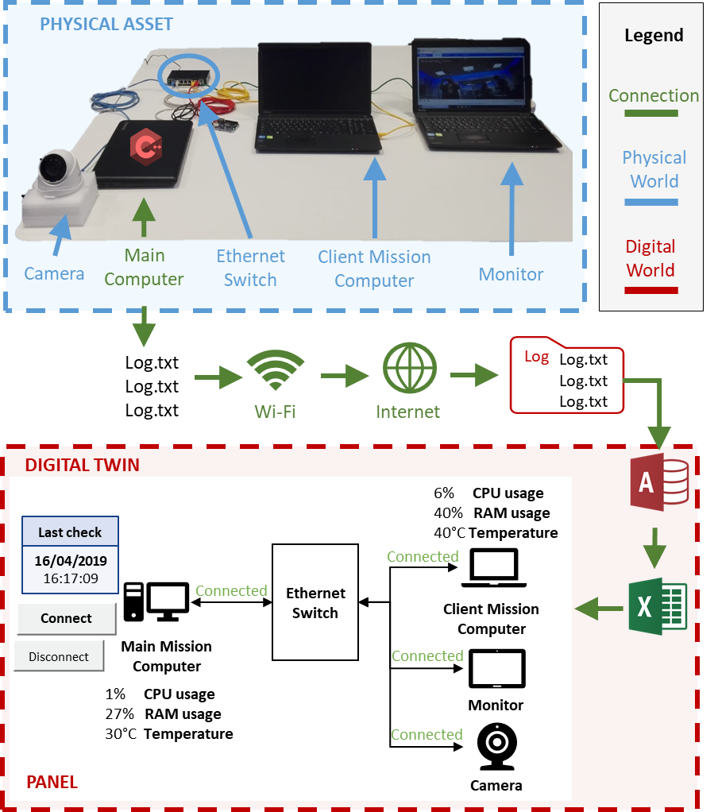
Demo #1 Helicopter computer system
Fig. 1: DT system architecture for condition monitoring of computer system in helicopter

Slide 4
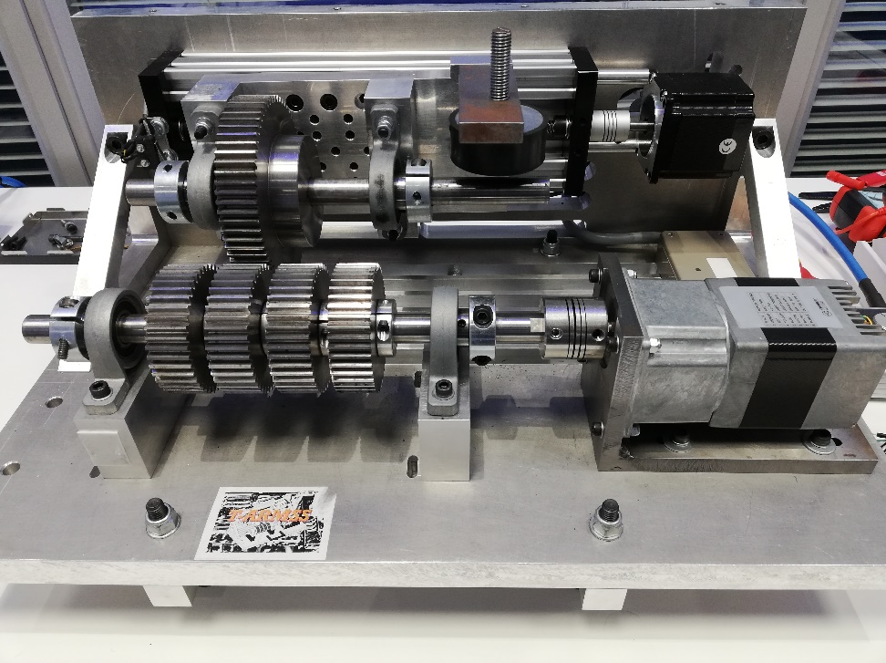
Your turn
From what you have learned in the previous lecture about Digital Twin, now you are given a task to build a DT system of a gearbox machine for a condition monitoring system – show DEMO #2 Digital twin of a gearbox machine
Fig. 2: Gearbox machine
Notes:
Two objectives to be fulfilled when building this DT
DT can help to monitor performance degradation of the output gear before failure occurs
DT can help to increase the availability of the gearbox machine (reduce downtime)

Slide 5
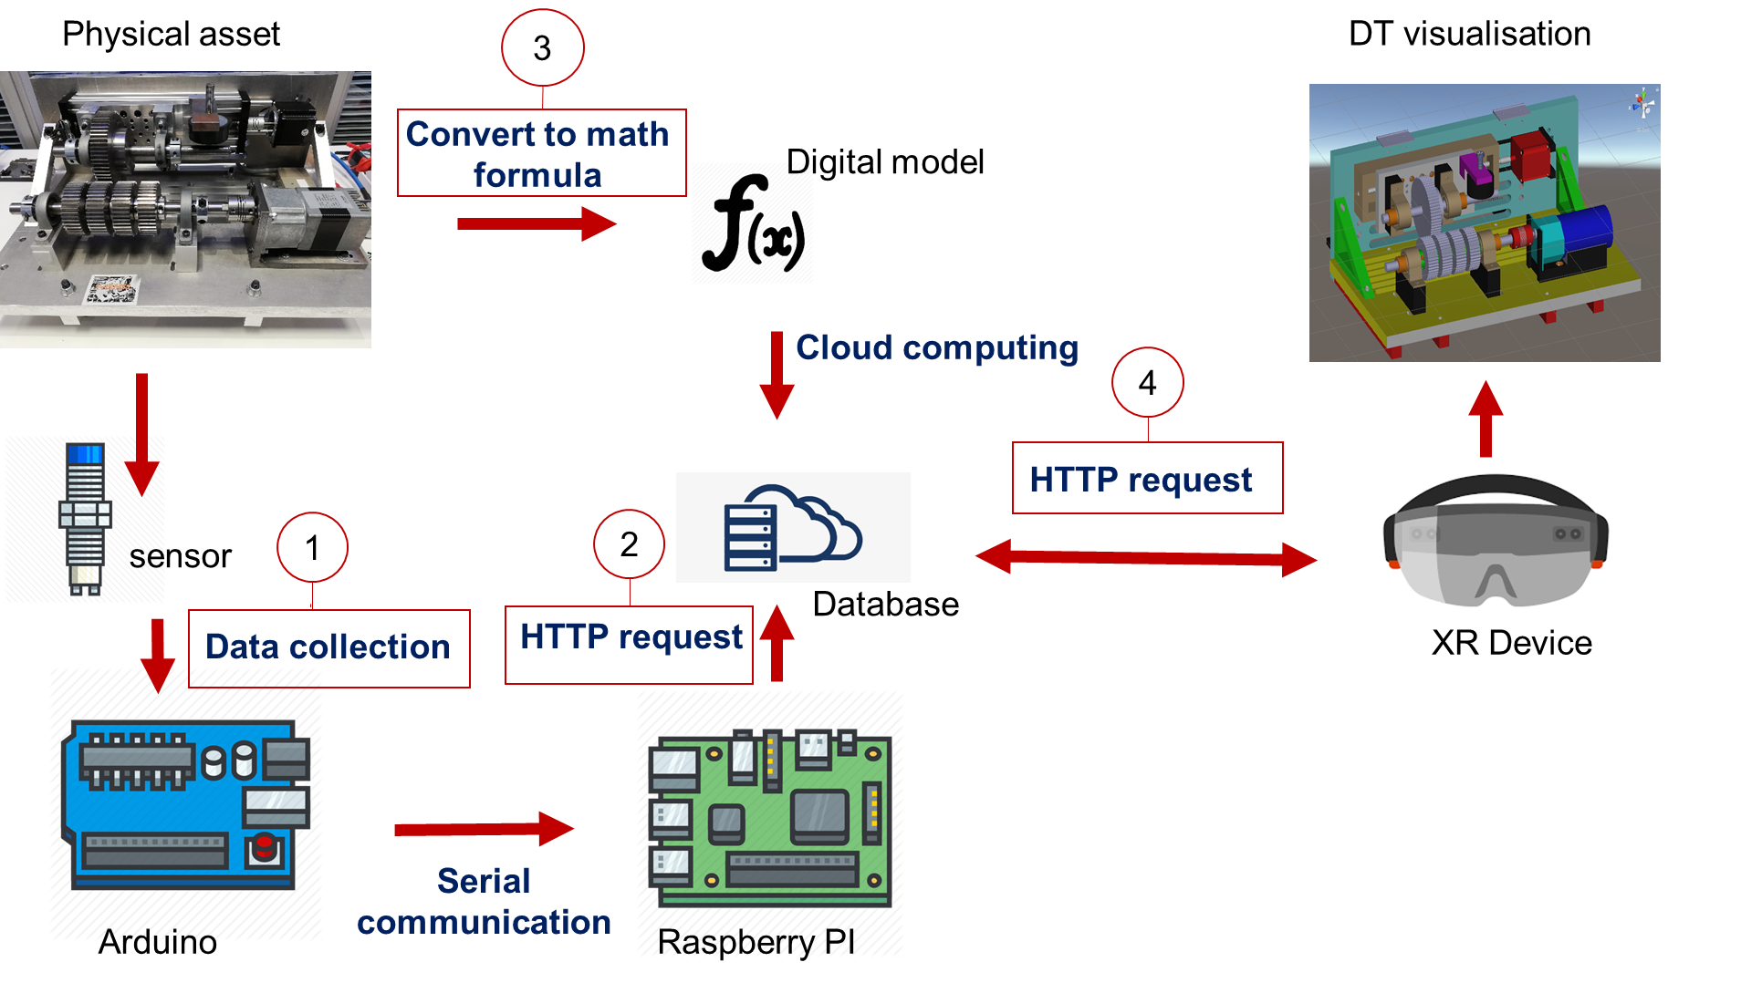
Modules for building digital twin
Group work:
Data collection
Sending data to a database server
Modelling the physical asset
Data retrieval to drive Digital Twin
Fig. 3: System Architecture of DT Gearbox

Slide 6















How is a digital twin built?
Step 1
Define the requirements
Step 2
Develop the information flow
Step 3
Build the virtual representation
Step 4
Develop the data exchange system
Step 5
Verify
Step 6
Carry out analysis
Step 7
Develop actions
Step 8
Validate
Aim of the digital twin
Data needed
Constraints
Different sources of data (sensors, internal software, historical data, etc.)
Data storage
Does the digital twin work properly?
3D
2D
Network communication
Connection security
Is this model working right ?
Output analysis
Decision making
Actions
Does the digital twin meet its purpose?
Fig. 4: Building steps of the digital twin

Slide 7
Design elements of DT system
Physical world
Equipment/Actuator (perform functions)
Digital world
Source code of software
Connection
Sensor (detect physical parameter)
Controller (transmit control commands)
Device for networking (antenna, transmitter, receiver)
Data repositories (database)
Data management (RDBMS, Ontology)
Digital model (CAD models, schematic, CAE models, numerical models, statistic models, etc.)
Network & connectivity IT
Intelligence (machine learning, deep learning)
Visualisation device (desktop, VR/AR/XR devices)

Slide 8
Step 1. Define the requirements
Physical world
Equipment/Actuator (gearbox)
Digital world
Source code of software (?)
Connection
Sensor (?)
Controller (?)
Device for networking (?)
Data repositories (?)
Data management (?)
Digital model (?)
Network (?)
Intelligence (?)
Visualisation device (?)
Connectivity IT (?)
Security (?)
The aim of DT
What is the expected outcome?
To monitor the performance degradation of the gearbox (i.e. gear) before failure occurs
What is the expected improvement?
Downtime reduced -> availability increased
What data are needed?
Rotational speed, vibration, temperature
Constraints?
Lack of sensor data and material degradation model

Slide 9
Step 2. Develop the information flow
What are the data sources?
Proximity sensors, encoder, piezoelectric, data from controller (Arduino, Raspberry PI, PLC controller), source code of software, user input, etc.
What type of data storage to use?
SQL database, non-SQL database, SPARQL database
What data management to use?
RDBMS, Ontology
Physical world
Equipment/Actuator (gearbox)
Digital world
Source code of software (gear equation)
Connection
Sensor (Proximity sensors)
Controller (Arduino, Raspberry PI)
Device for networking (?)
Data repositories (MySQL database)
Data management (RDBMS)
Digital model (?)
Network (?)
Intelligence (?)
Visualisation device (?)
Connectivity IT (?)
Security (?)

Slide 10
Step 3. Build the virtual representation
How the DT is visually represented?
Desktop-based 2D, Virtual Reality, Augmented Reality, Mixed-reality
3D CAD model of physical asset is needed
Physical world
Equipment/Actuator (gearbox)
Digital world
Source code of software (gear equation)
Connection
Sensor (Proximity sensors)
Controller (Arduino)
Device for networking (?)
Data repositories (MySQL database)
Data management (RDBMS)
Digital model (CAD model)
Network (?)
Intelligence (N/A)
Visualisation device (AR device)
Connectivity IT (?)
Security (?)

Slide 11
Step 4. Develop data exchange system
How large is the network coverage area?
Personal Area Network (e.g. Bluetooth)
Local Area Network (e.g. Reuter)
Wide Area Network (e.g. Modem)
What is the connection protocol?
TCP
UDP
Physical world
Equipment/Actuator (gearbox)
Digital world
Source code of software (gear equation)
Connection
Sensor (Proximity sensors)
Controller (Arduino, Raspberry PI)
Device for networking (Router)
Data repositories (MySQL database)
Data management (RDBMS)
Digital model (CAD model)
Network (LAN and WAN)
Intelligence (N/A)
Visualisation device (AR)
Connectivity IT (TCP/IP)
Security (N/A)

Slide 12
Step 5. Verify
Physical world
Equipment/Actuator (gearbox)
Digital world
Source code of software (gear equation)
Connection
Sensor (Proximity sensors)
Controller (Arduino, Raspberry PI)
Device for networking (Modem and Router)
Data repositories (MySQL database)
Data management (RDBMS)
Digital model (CAD model)
Network (LAN and WAN)
Intelligence (N/A)
Visualisation device (AR)
Connectivity IT (TCP/IP)
Security (N/A)
Physical asset
Check if physical asset is running properly
Data logging
Check if sensors are properly installed
Check if right data are measured
Data storing
Check if all desirable data are stored properly
Data reading
Check if DT read the right data from database
Data processing
Check if the right data are fed into the right program/source code
Check if there is a bug in the source code
Data visualisation
Check if the the status and behaviour of displayed DT reflects its physical twin

Slide 13
Step 6. Carry out analysis
Manual analysis
Compare data record at different times
Semi-automatic analysis
Identify patterns of data
Automatic analysis
Rule-based data analysis
Multi-physics analysis
Statistical analysis

Slide 14
Step 7. Develop actions
Define condition-action rules
Reduce the demand on the current asset and distribute it to the standby asset
Initiate maintenance schedule on the current asset
Shut down the operation of the asset

Slide 15
Step 8. VALIDATE
Validate the capability of the DT system to monitor the degradation of gears before failure occurs
Conduct an experiment to test whether a user can recognise the early indication of gear deterioration with and without DT
Validate the capability of the DT system to improve the availability of the gearbox machine
Conduct a periodic inspection to assess whether condition-action rule informed by DT improve the availability of the asset in comparison with the asset without DT

Slide 16
References
Agha et al., 2019. “Digital twin representation. . .”
Stark, Rainer, Carina Fresemann, and Kai Lindow. "Development and operation of Digital Twins for technical systems and services." CIRP Annals (2019).

